Slide 1

Online Course with Laureate:
Development and Implementation

Slide 2
Online Course with Laureate:
Development and Implementation

Slide 3
Online Course with Laureate:
Development and Implementation

Slide 4
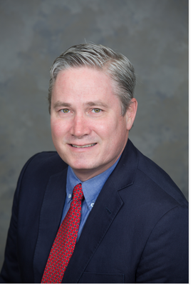
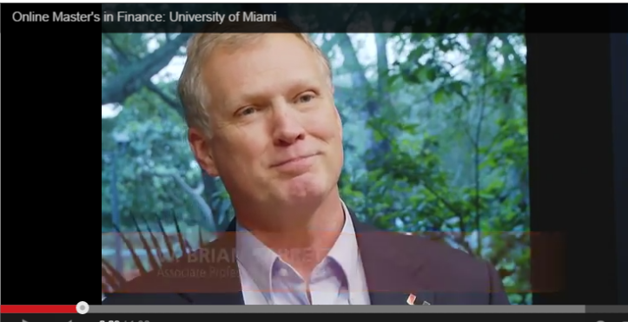
Thanks for this opportunity today!
Tim!
Brian!

Slide 5
Outline
Big picture issues
  Goals, student body, and where U is going
  Faculty incentives
  How is working with Laureate?
  Role of faculty vs. Laureate vs. UM
Overview of course development process
What my course looks like & what teaching an online course involves

Slide 6


The Kevin O’Leary Business Education Model?
Is it All About The Money?
Let’s compare to exed ed programs

Slide 7
To me the students seem somewhat similar to our exec ed students (a few a little older)

Slide 9
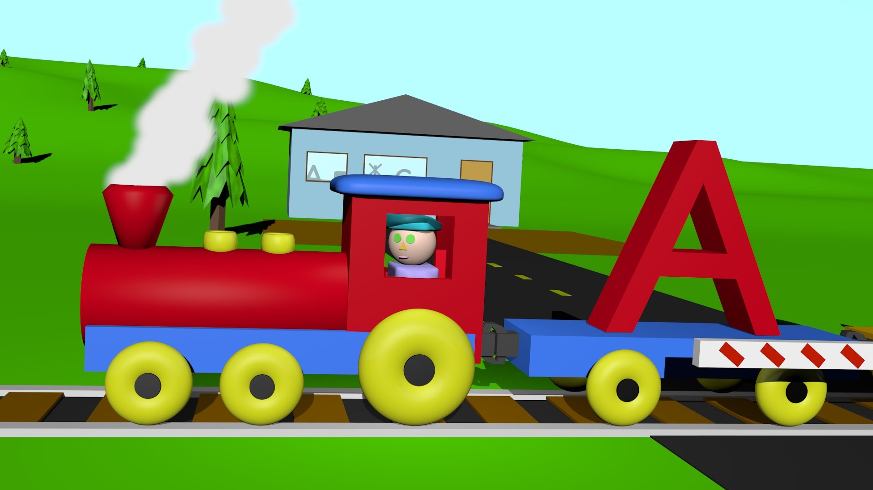


The online train is leaving! http://www.miami.edu/ http://www.miami.edu/index.php/registrar/calendar/
http://i.ytimg.com/vi/YUtvaCGx05g/maxresdefault.jpghttp://i.ytimg.com/vi/YUtvaCGx05g/maxresdefault.jpg

Slide 10
Faculty incentive structure
Lump sum for developing a course
Each time class runs, the faculty director of the course receives a payment
    MSF has three program intakes per year, so each course is taught three times each year
Smaller payment for each section taught
  Sections (for MSF at least) are planned at approx. 20-25 students
  Plan is to scale via adjuncts to teach the extra sections—a faculty director teaches one section or maybe even no sections

Slide 11



Working with Laureate: The big picture
THE AND THE
OK IMPROVING
Notes:
ffff

Slide 12
Roles of faculty vs. Laureate vs. UM Central
Faculty
  Complete control over content
  Consults with Laureate to select structure of material, assignments, assessment, etc. within an online framework
  At programmatic level, determines admissions rubrics and makes trickier admission decisions (auto-admit vs. faculty review)
  Teaches, engages with students, grades (to the extent not automated)
  You have autonomy…just that there are expectations on engagement

Slide 13
Roles of faculty vs. Laureate vs. UM Central
Laureate
  Builds the site, updates it with corrections, etc.
  Recruits and trains the students
  Helps with copyediting (but no expertise on subject matter!)
  Weekly conference calls to discuss any problems and potential tweaks
    Faculty, Laureate, and UM Central collectively discuss

Slide 14
Roles of faculty vs. Laureate vs. UM Central
UM Central
  Provides local tech support
    Remember this is not a B-school project per se – rather a UM initiative run through Provost office
    UM Central is a work in progress with tech support, equipment, etc. -- B-School has had my back and everything with UM now being sorted out
    This is improving and we are almost there
  Interacts with Laureate on faculty’s behalf as needed—has been very supportive in this regard
  Each faculty member signs contract with UM (before course development I recommend)

Slide 15
Course development process
Will be somewhat course and faculty specific, but here is how it worked with me
  Step 1. “Course Summit” (half-day+) meeting to outline how the course will be designed
    Blackboard is the platform - Laureate will build the site
  Step 2. Faculty submits material to Laureate, e.g. one week of material each week
  Step 3. Laureate reviews, hold conference call with you to discuss edits
  Step 4. Filming at studio in the library
    For introductions of course and each week
    Taped class lectures or video of you presenting on campus is NOT the model
  Step 5: Laureate works behind the scenes to build the site…course is completed and you are trained during the week before it begins

Slide 16
Course development process
I’m happy to discuss a few tips and insights with anyone…do’s and don’ts as you go through development process!

Slide 17
What my course looks like & what my teaching has involved
BUS 640: Quantitative and Analytical Fundamentals for Finance – 7-week, 4-credit course in online MSF program
  100% online, although I have had a few phone conversations with one student to discuss big picture, non-course topics
Mostly I respond to students first thing in the morning and in the evening…10-20 min per day
Weekly online office hour (I chose Thursdays, 7 pm) – Adobe Connect - I record and post these

Slide 18
What my course looks like & what my teaching has involved
Sunday afternoons: some grading and building feedback “library” that can be used in the future
Weekly conference call with Laureate and UM Central, plus some emails for corrections and other tweaks
After 3rd week I began recording and posting one or two weekly 15-20 minute videos of me working through problems on a tablet—will post these in future courses of course

Slide 19

Students expect relatively frequent engagement (I’m briefly in the course twice a day usually)

Slide 20
A quick look
https://elearning.miami.edu/

