Slide 1
Corporate Scandals & Household Stock Market Participation Mariassunta Gianetti & Tracy Yue Wang Discussion by Timothy R. Burch (University of Miami) 2014 EFA Conference, Lugano, Switzerland

Slide 2
Corporate Scandals & Household Stock Market Participation Mariassunta Gianetti & Tracy Yue Wang Discussion by Timothy R. Burch (University of Miami) 2014 EFA Conference, Lugano, Switzerland

Slide 3


Mariassunta Gianetti Tracy Yue Wang Timothy R. Burch
The importance of networking
(Stockholm School of Economics, CEPR & ECGI)
(University of Minnesota)
(University of Miami)

Slide 4

Discussion Checklist
Thanks for the opportunity to discuss
Enjoyable paper–recommend reading
Recap of main contribution
What’s to like
Trash the paper / what could help
Work in gratuitous reference to own work
Close by reiterating some positives

Slide 5
Disclaimer
Common in movies:
All characters appearing in this work are fictitious. Any resemblance to real persons, living or dead, is purely coincidental
My discussion disclaimer:
The following comments are my own and any resemblance to those of a prior discussant is purely coincidental

Slide 6
What’s to like
Important topic
Stock market participation is obviously important
Mature, empirically well-executed paper
Results are economically significant and seem robust
Two-pronged approach to establish causality
Exogenous shock to fraud revelation (AA demise)
Exploit variation in household’s prior exposure to fraud

Slide 7
Quibbles and Room for Improvement

Slide 8
Motivation & Context
Would be nice to reference/discuss trust in other contexts
“Money Doctors” by Gennaioli, Shleifer, & Vishny (forthcoming JF) – trust in professional money management
2003 Mutual fund trading scandals
“[401(k)] Participants were already nervous about declining investment markets, soft job prospects, and increased healthcare costs -- now they have mutual fund trading to worry about as well," said Nevin Adams, Editor-in-Chief of PLANSPONSOR
Some ethnic groups have lower stock market participation, contributing to wealth disparities
American Hispanics distrust financial institutions -- due to experiences in South and Central America?

Slide 9
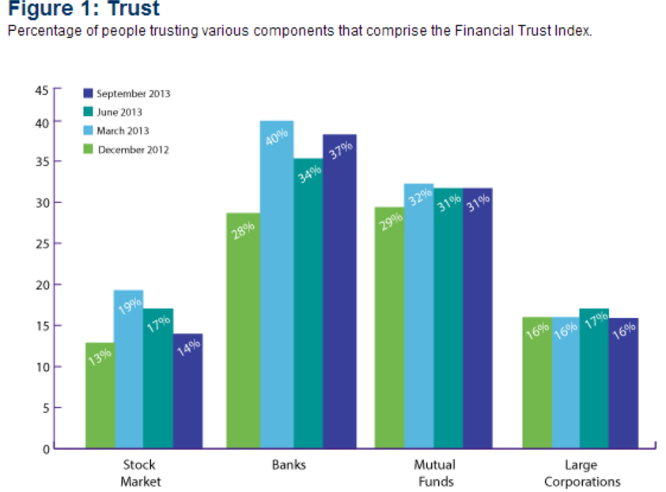
Motivation & Context
Chicago Booth / Kellogg School Financial Trust Index

Slide 10
Motivation & Context
“Why should we care?”
The paper: ↓demand for equity ➔ ↑ cost of capital
However, paper also finds substitution effect because we see ↑ demand for bonds
Isn’t it unclear how strong net effect is on overall cost of capital? Is it actually unclear there is a “negative externality on financial markets” once this substitution effect is considered?
Suggestion: What about saving for retirement, college tuition, etc.?
Even with substitution into fixed income, historical rates of return suggest individuals’ long-term wealth accumulation would be harmed

Slide 11
What, precisely, are the frauds studied?
Bribery, obstruction of justice, etc. excluded from sample
Can we characterize the sample as essentially earnings management that crossed the line to varying degrees?
Securities & Exchange Commission defines “abusive earnings management” as a “material and intentional misrepresentation of the results”
Yes “shareholders experience large financial losses upon the fraud revelation”
However, if I am a long-term investors I have enjoyed more stable and perhaps higher returns before the revelation
So, should I really care? Should I actually only care about the fine and any externalities created? More discussion of why investors care would be nice

Slide 12
Investor sophistication
Sophisticated investors should be diversified and less likely to reduce their overall stock market participation in response to firm-specific events
As you note, Guiso, Sapienza and Zingales (2008)’s paper on trust and stock market participation finds that a reduction in trust more strongly affects the participation of unsophisticated investors
However, you find “the effect of fraud on stock market participation is entirely driven by individuals with a college degree”
Largely unsuccessful in explaining (e.g., not
caused by shift in risk aversion)

Slide 13
Measuring investor sophistication
I suggest measuring investing sophistication…
You are using that mysterious, completely anonymous 1991-1996 brokerage data from a completely anonymous brokerage firm
You can (and should!) measure investing sophistication on the basis of Portfolio Size, Diversification Level, Investing Experience (within the dataset of course), Observed Behavioral Biases (e.g., disposition effect), etc.
This may recover what we actually expect for the link between sophistication and the propensity to let trust affect stock market participation

Slide 14
Suggested confirming analysis
Do we see stronger effects for more serious fraud, where magnitude of fraud is measured by
Market reaction to revelation, or
Magnitude of the fine imposed
How about high vs. low corruption states
Is effect weaker when investors are jaded and desensitized (by non-corporate fraud events)

Slide 15
Suggested confirming analysis
I was surprised the paper does not use the brokerage data to document investors sell the companies specifically caught with fraud (did I miss this?)
Some will sell, some won’t…should correlate with changes in their overall stock market participation (in other stocks)
Can you exploit the aggregate time series?
Would we expect stock market participation to be more/less strongly affected during certain time periods, for example
Late 1990s: end of incredible bull market and significant wealth accumulation in the stock market…was “trust in the stock market” at an all time high?
How about crash of the tech bubble?
How about the wake of Enron & MCI Worldcom?

Slide 16
A question…
Entry and exit statistics warrant further discussion – something strange in the data?
Mean annual exit rate in the sample is 32%
Mean annual entry rate is only 9.7%
What does this imply over time?
Also, how permanent are the effects you document?

Slide 17
On exploiting variation in investor fraud experience
Not sure this is as helpful as argued – is the prior actually clear?
If I understand correctly, your premise is that repeated exposure to fraud will undermine trust in the stock market
However, perhaps investors learn that the occasional fraud within a diversified portfolio is only firm-specific risk
And perhaps investors also become desensitized and overreact less to repeated fraud

Slide 18
I must be over my time limit by now!
Enjoyable read on interesting topic
Mature paper with well-thought-out and well-executed empirics, though I do suggest a small amount of additional work would make the paper even better
Fully expect an excellent publication result and broad reader interest!

